Slide 1


DATA
KN GHTS

Slide 2
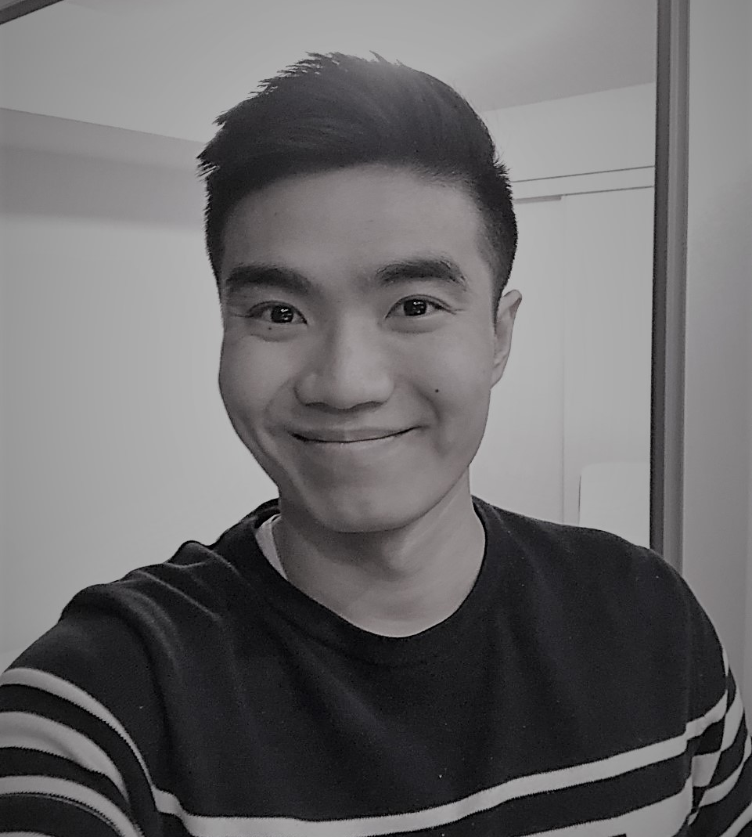

ALEX FUNG
Alex Fung is a Machine Learning Engineer at RBC. For the past year and a half, he has worked on several ML and AI projects, such as Trade Compliance ML models, AI-powered chatbots, and comparison of documents using document similarity techniques. Alex has also worked in full-stack development, leveraging various technologies such as Angular, Node.js, and Java. Alex studied Software Engineering with a Health Informatics Option at the University of Western Ontario.
CONTACT
Email : alexchunkwan.fung@gmail.com Phone : (519)-702-5827
LinkedIn: https://www.linkedin.com/in/cfung58/
Github: https://github.com/alexf388

Slide 3
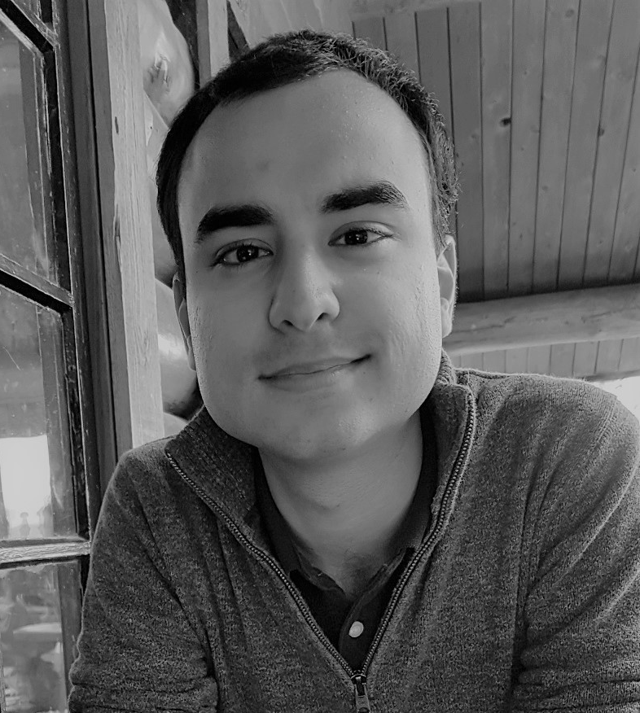
PATRICK OSBORNE
Patrick Osborne is a data analyst and business systems consultant who works with organizations eager to leverage their data toward continuous improvement and data driven decision-making. Over the last 6 years, Patrick has worked at KPMG LLP, Canadian Pacific Railway and York University in various project management and business systems focused roles. He thrives in demanding situations and has a passion for problem solving. Patrick holds a Bachelor of Applied Science in Business Informatics (Business and Computer Science) from McMaster University
CONTACT
Email : pmr.osborne@gmail.com Phone : 416-912-9390
LinkedIn: https://www.linkedin.com/in/patrickmosborne/
Github: https://github.com/patrick-osborne

Slide 4
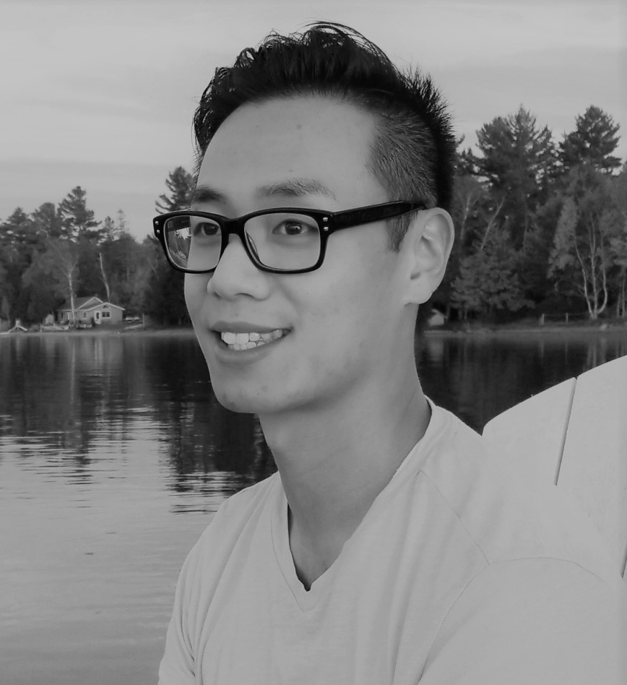
TONY LEE
Tony Lee is a Banking Advisor who works with everyday people to achieve their dreams and goals. Tony has a decade long experience in Sales, ran his own business and has been touted to be one of the fastest learners. Besides, he lived two years in New York City leading a team of 30 volunteers. Tony is certified with the Investment Funds Institute of Canada, holds two Bachelors degrees, one in Actuarial Science & another in Computer science both from UofT. Deep down, his true passion is for technology, computer science and math.
CONTACT
Email : tonyming.lee@outlook.com Phone : 647-216-8411
LinkedIn: linkedin.com/in/tonymlee
Github: https://github.com/Powahowa

Slide 5
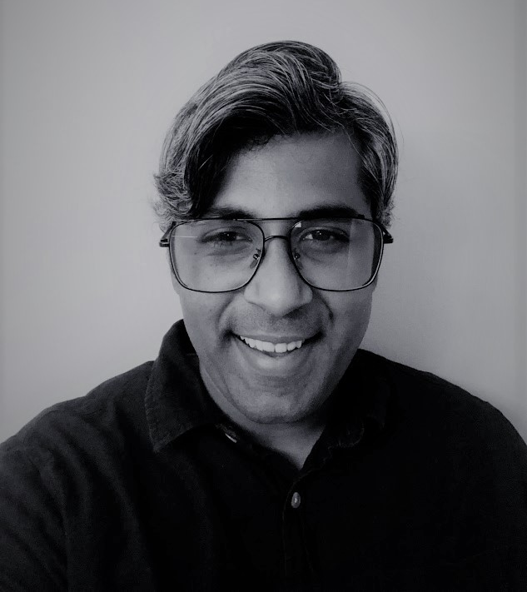
VISWESH(VIS) KRISHNAMURTHY
Vis is a strategic leader & a management consultant who works with companies across industries, helping them champion change, save costs and realize extraordinary value. He spent the last 12 years in business process optimization and running high-performance continuous improvement teams. He has experience across wholesale distribution in scientific supplies, packaging, global shared services and briefly in food processing. Viswesh has a Bachelors in Engineering (Electronics & Communication) from Anna University, he is an ASQ Certified Six Sigma Black Belt and an APICS Certified Supply Chain Professional. He currently runs his consulting firm, Fletch Consulting Inc.
CONTACT
Email : viswesh_kris@outlook.com Phone : 647-339-0853
LinkedIn: linkedin.com/in/visweshkrishnamurthy
Github: https://github.com/viswesh-ml

Slide 6
PROJECT AREAS
So far, “Data Knights” has tackled Machine Learning projects across many disciplines like traffic data analysis, sports analytics, retail recommender systems, NLP, Audio & Image classification. Every member of the team brings a different strength to the table and complements the team well. The different project areas of interest are listed below by team member. Irrespective of the project assigned, the team is confident about exceeding sponsor expectations.
ALEX
Academic Research
Public data analysis
PATRICK
Workforce / HR analysis
Marketing
TONY
FinTech
Edge computing
VISWESH
Manufacturing
Logistics & Supply chain

Slide 7
ML TOOLKIT
Over the last 6 months, the team has gained knowledge of a wide variety of ML tools. The team has consistently been learning new concepts and adding to their ML toolkit. Seen below, is a shortlist of tools & capabilities.
Extensive experience with audio analysis/machine learning numerical/vector and image-based features, Cloud/GPU accelerated
Neural networks for image recognition
Google Cloud services and implementation
Geospatial modelling
UX Design and interactive results presentation/app development
Business and proposal writing/data science in clear language
NLP sentiment analysis
NLP text classification

Slide 8
TEAM COMMUNICATIONS
Every member of the team is equally available for meetings with the course instructor and project sponsors. However, Patrick & Viswesh will act as team coordinators and be each other’s backup. We’re flexible about meeting schedules, however, our preferred cadence is bi-weekly.
CONTACTS:
Patrick Osborne – Ph: 416-912-9390 Email: pmr.osborne@gmail.com
Vis Krishnamurthy – Ph: 647-339-0853 Email: viswesh_kris@outlook.com
HIRING AVAILABILITY
Alex – Open to full time opportunities
Patrick – Open to volunteer, consulting & part-time opportunities
Tony – Open to full time opportunities
Viswesh – Open to consulting and / or contract opportunities

